Slide 1
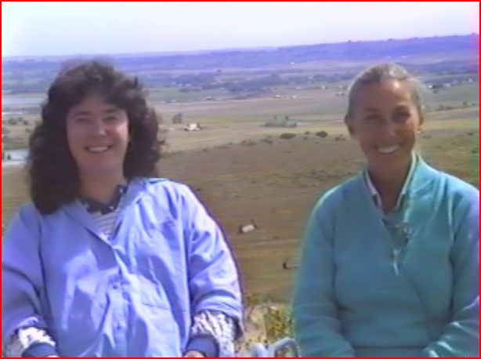
Notes:
1984 Anna Wise and Linda Tellington-Jones EEG Study with Horses and Humans
When Linda and Anna met in 1983, the year prior to this project, Linda learned that she was functioning in the Awakened Mind State with strong symmetrical hemispheres, strong symmetrical beta and access to theta at 7.5 Hz during meditation. From Anna’s experience, during a meditation, the lower the alpha frequency the more experienced the meditator and Linda’s alpha was so low, it had actually slipped into theta during meditation.
The purpose of this work with Anna was to document the EEG markers that might suggest that horses and humans involved in TTouch and TEAM were entering the Awakened Mind State during sessions that provided for a very special kind of communication. Linda knew from experience that she could affect the behavior, personality and performance of a horse through TTouch and TEAM work. Linda has said she was increasing the horse’s potential for learning through her system of touches and movements and that an interspecies connection was enhanced through the feelings of trust and safety generated in the body by this touch. In Linda’s own words, “When we touch an animal, we are not only affecting the health of that animal, we are also affecting our own health. That animal becomes our teacher and we are involved in that non-verbal interspecies communication that I think is going to make a difference to our planet.”

Slide 2
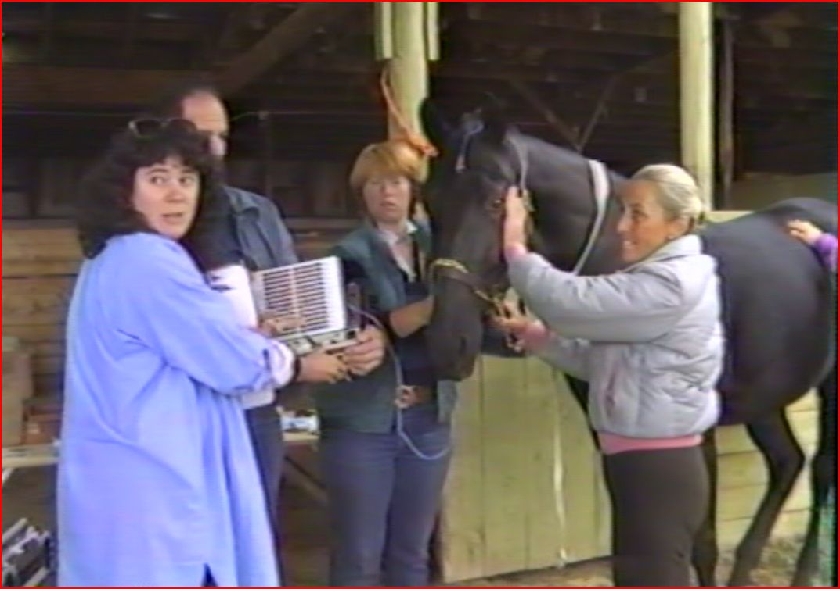
Notes:
Eleven people who were experienced in TTouch were evaluated with the Mind Mirror in a baseline and TTouch condition. The baseline consisted of each person being measured while talking, doing mathematics and thinking of a stressful situation with eyes open and relaxing with eyes closed. Then each person was measured in a TTouch session with hands on a horse. Anna was interested that the TTouch students demonstrated portions of the Awakened Mind state in the left hemisphere and were particularly strong in delta and theta. Perhaps people who are drawn to TTouch have this tendency or perhaps this pattern was developing in response to learning TTouch. There was no way of knowing. Out of the 11 TTouch students, 8 demonstrated some form of the Awakened Mind and 2 people showed the full Awakened Mind pattern.

Slide 3
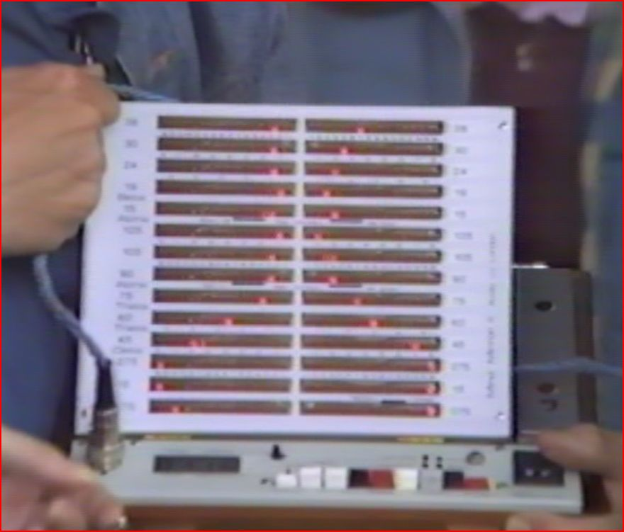
Notes:
Summary of EEG Studies from 1984 and Midnight’s Awakened Mind. Midnight was measured with the Mind Mirror in a resting state. Anna had never measured a horse before, but she was fairly comfortable interpreting the EEG within the same general framework as she would a human since all mammalian brain structure is similar. Anna noted that Midnight had predominantly delta and theta brain waves but with evidence of left hemispheric beta – Anna felt the horse was thinking. The delta was understood as Midnight’s orienting response and subconcious attempt to reach out into its environment for the purpose of communication. Midnight was not showing a lot of alpha suggesting that he might feel uncomfortable with the equipment and people around him.
The TTouch session began with multiple people putting hands on the horse at the same time and Midnight’s delta and beta activity increased in the left hemisphere. Anna felt that Midnight was analyzing what was happening with left mode processing. As the session continued, Midnight produced a lot of delta and a little bit of beta without any alpha to show a disconnection between the subconscious instinctual orienting response and conscious evaluative brain response. According to Anna and Linda, this disconnection is what prevents the horse from using its thinking beta brain waves from managing or overriding the reflexive orienting fight/flight response or fear based reactions.
Anna noted the interesting behavior of head shaking or shifting in position associated with a shift in the brain wave pattern. When a handler began to do Tarantula Pulling the Plow on Midnight’s back, some beta waves developed which were understood to show thinking and an attitude of interest. The horse wanted to move its head. The handler’s had wanted to keep Midnight’s head still for the EEG measurements until it was understood that this movement was a natural response that occurs when the horse changes brain states.

Slide 4
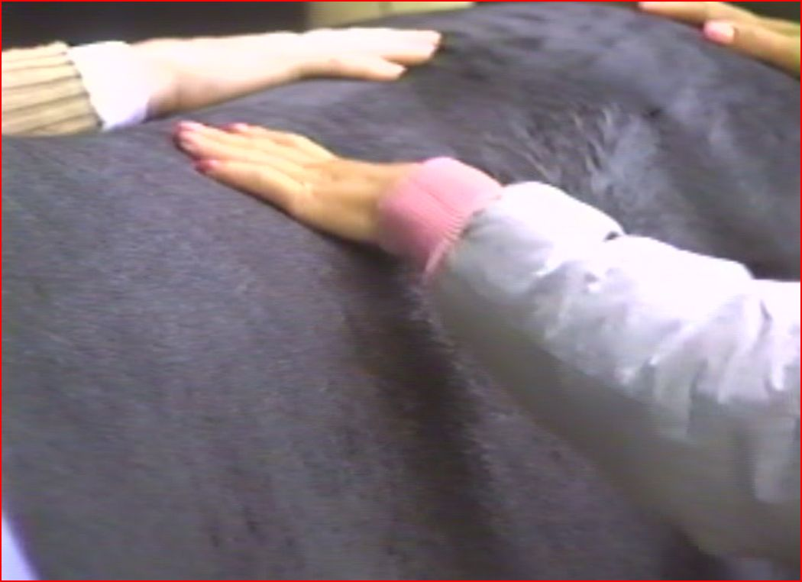

Slide 5
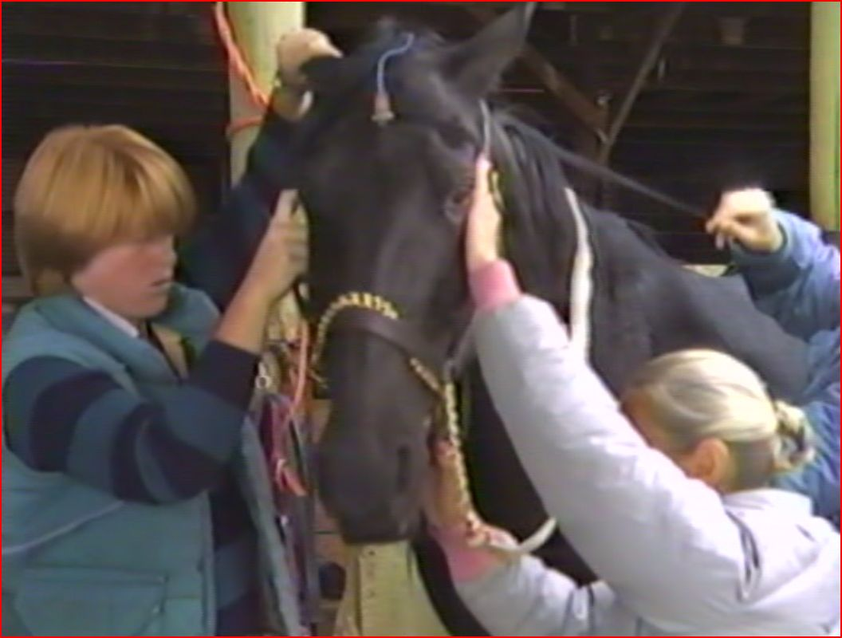
Notes:
Midnight’s EEG began to show muscle artifact that intruded on the quality of the reading. This was understood by Linda as Midnight’s need for a muscular release of building tension. Linda told three people to work more deeply and Midnight began to generate a small amount of alpha at 9 hertz and 12.5 hertz in the right hemisphere that would predict a growing calmness in Midnight’s body. As the three continue to TTouch Midnight, Anna noted the development of clearly differentiated theta waves suggesting that Midnight was experiencing some preconscious awakening. Someone moved behind Midnight to work on his tail, and an enormous beta flare was seen. These beta flares were believed to show that Midnight was paying attention and thinking about what may be happening around his haunches.

Slide 6
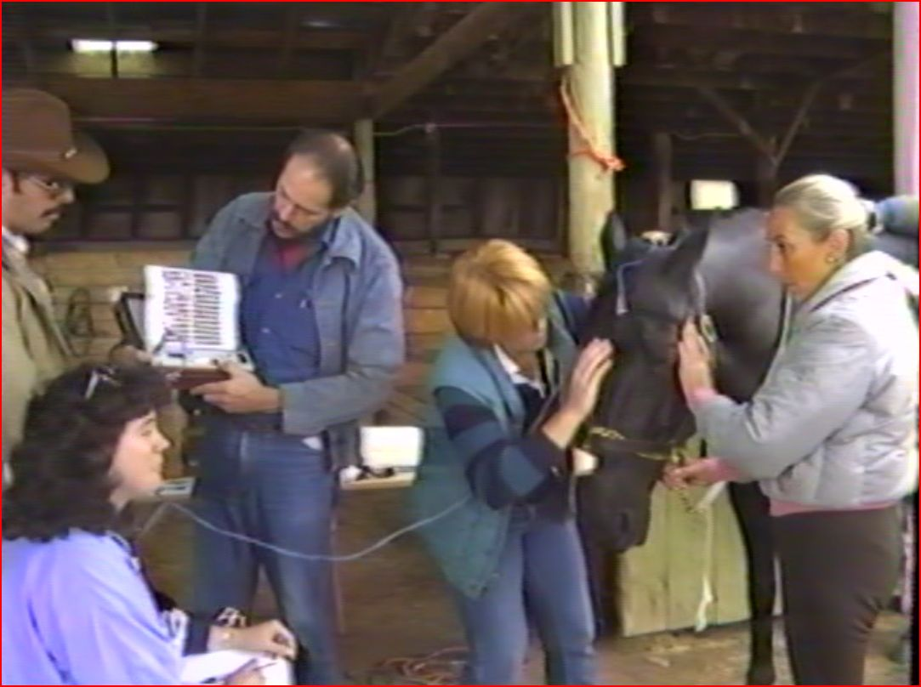
Notes:
Linda decided that Midnight needed some help with relaxation because the beta wave flares became so large they indicated Midnight felt anxious. She began to work across the horse’s back gently with her flat hand which inspired Midnight to take a breath and produced alpha for the first time in the session. Linda had noticed tension in Midnight’s diaphragm and she wanted to help release it. As she worked across the acupressure point for the diaphragm with TTouch and while Linda was in the middle of releasing the diaphragm, Midnight showed an Awakened Mind pattern for a few moments. Amazed, Anna wondered if Midnight was picking up the Awakened Mind from Linda or if he was generating that for himself.

Slide 7
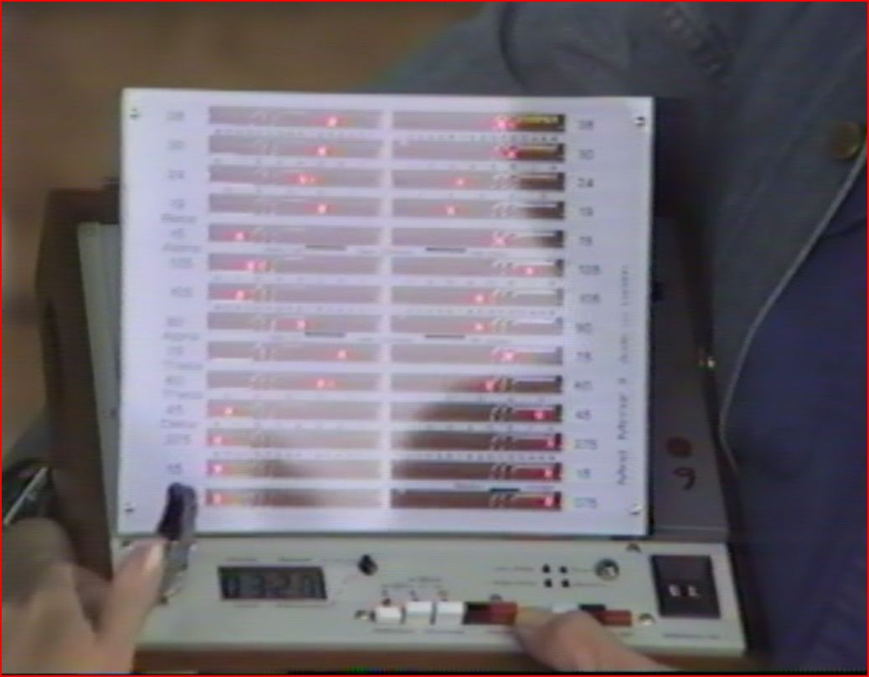
Notes:
Linda decided that Midnight needed some help with relaxation because the beta wave flares became so large they indicated Midnight felt anxious. She began to work across the horse’s back gently with her flat hand which inspired Midnight to take a breath and produced alpha for the first time in the session. Linda had noticed tension in Midnight’s diaphragm and she wanted to help release it. As she worked across the acupressure point for the diaphragm with TTouch and while Linda was in the middle of releasing the diaphragm, Midnight showed an Awakened Mind pattern for a few moments. Amazed, Anna wondered if Midnight was picking up the Awakened Mind from Linda or if he was generating that for himself.
When Midnight’s handlers become distracted and started to talk amongst themselves, Midnight’s initial EEG pattern re-emerged. Linda felt Midnight had drifted back because of the handlers’ reduction of focused attention on him. Linda re-organized the team and brought a lot of stimulation to the horse’s body with larger circles and more pressure. Midnight seems to enjoy this, but the large amplitude of Midnight’s brain waves then indicated that he was being highly stimulated. To settle Midnight, Linda lowered his head and Midnight’s brain waves become the Awakened Mind pattern. Lowering a horse’s head induces calm in the body. Everyone stopped touching Midnight, to see what would happen to the Awakened Mind pattern. Midnight’s original pattern readily re-emerged, but with more beta and alpha amplitude than before. The additional beta meant that Midnight was more outwardly focused than he had been and the increased alpha could create a bridge between his subconscious instinct and he ability to think. Linda brought Midnight’s head down again and Anna indicated that the pattern with the alpha bridging the thinking and the instincts had returned. In essence, these were the very signs that suggested Midnight was more self-aware and in a position to mediate impulses. Excitedly, Linda stated “This is what the TEAM work is all about. It is making the horse aware so that they can learn to deal with the world by figuring it out, rather than responding instinctively!”

Slide 8
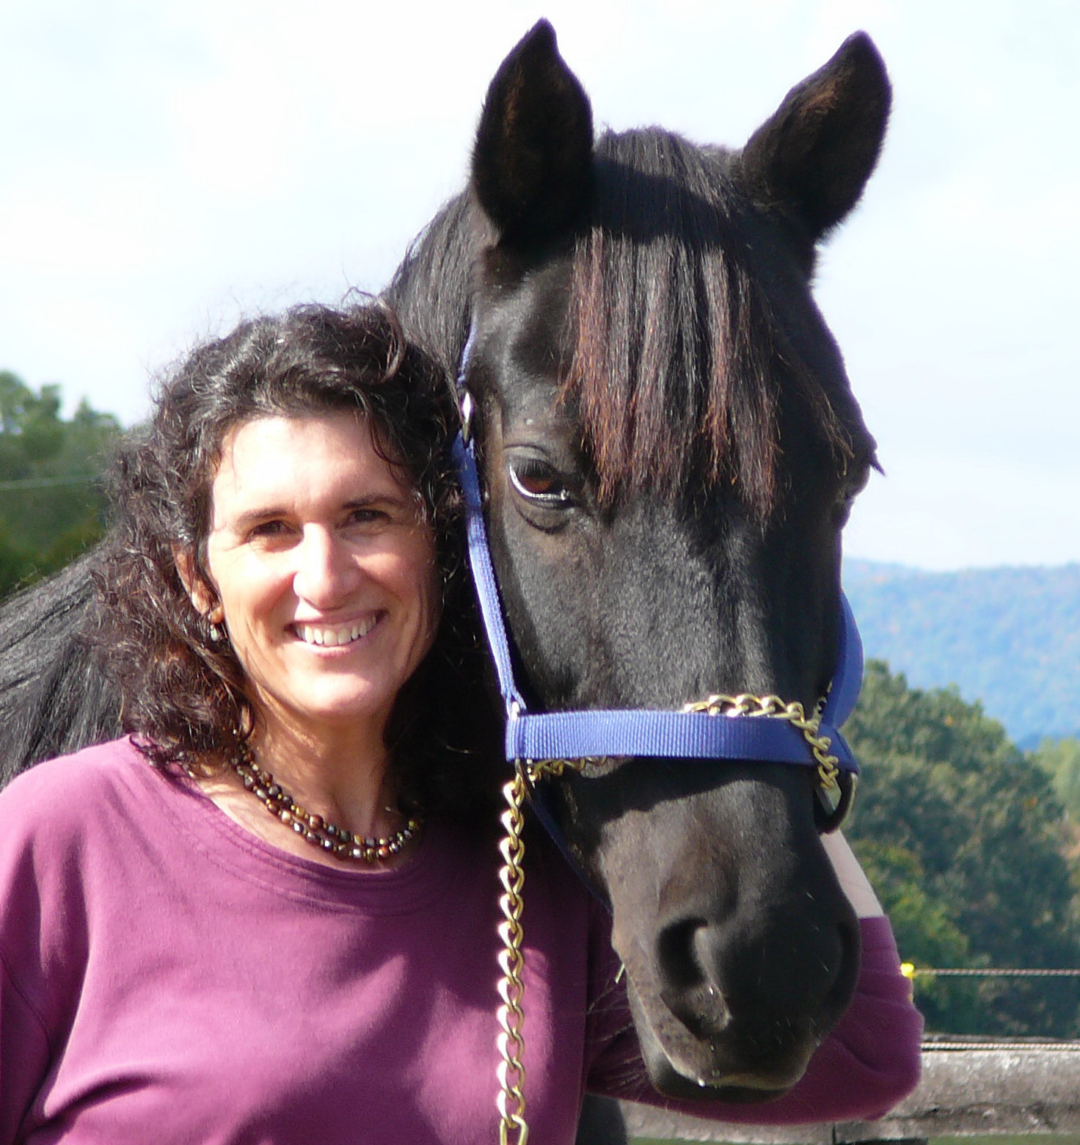
Notes:
Grace was the star of our first equine EEG performed at Toad Hollow Farm in Crozet, VA.

Slide 9
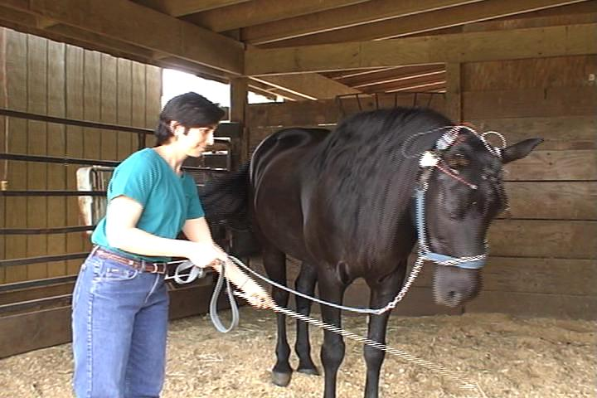
Notes:
Sandy Rakowitz stroking Grace in 2005. We are recording her frontal lobes during this three minute session as she relaxes into TTouch stroking with a wand.

Slide 10
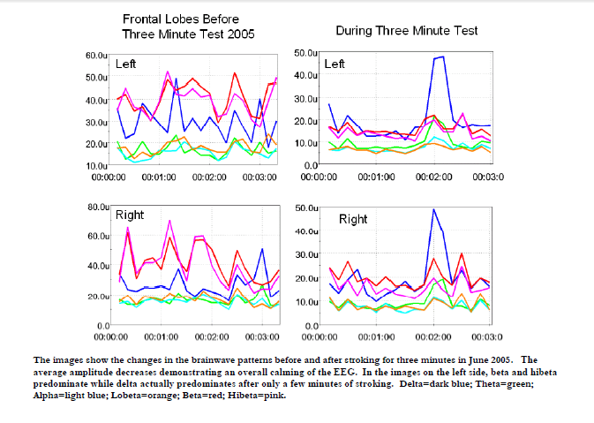
Notes:
Practice Recording Before Beginning Three Minute Tests and The Equine EEG: The Immediate and Long Term Benefits of a TTEAM Program for a Distressed Horse
First Three Minute Test Showing Calming of EEG in the Frontal Lobes: the peak of blue shows concern when we shifted from stroking the chest to the hind end. This peak of interest or concern is then followed by more calming. Hypervigilance associated with hibeta brainwave activity was noted during resting. While resting, hibeta activity was found to be greater in the right frontal lobe, an indicator of anxiety and impulse control issues. After stroking, the hibeta activity reduced in the right frontal lobe and increased in the left frontal lobe, a pattern associated with sequential thinking in humans. The beta activation in the left frontal lobe while the horse was attending to the sensations created by being stroked with the wand was considered suggestive of “horse thinking.” This finding of increased beta, especially in the left frontal lobe supports the earlier work by Anna Wise and Linda Tellington-Jones in 1987 and 1988.

Slide 11
Notes:
Immediate and Cumulative Benefits from Tellington TTouch Program Reflected in the EEG of An Anxious Mare Robin Bernhard, LCSW, MEd, Sandy Rakowitz, Jessica Eure, MEd, EdS
Linda Tellington-Jones has created a gentle non-invasive system of bodywork comprised of specialized circular touches, lifts and slides that improves focus, balance and motor function, enhances learning and even promotes trust and communication amongst its users. Over the past 30 years, practitioners have seen both immediate and cumulative benefit from its use in training and healing animals and in healing the relationship between animals and their owners. After attending one of Linda’s 5-day workshops in April 2005, I wanted to see if these techniques could help my injured mare to be comfortable while healing from a ligament injury and help us to improve our ability to communicate so that her balance problems under saddle would not degenerate into rushing out of control. We used subjective observation and objective brain wave measurements to evaluate the efficacy of the TTouch method. The EEG, or the electroencephalogram, is a measurement of the energy emitted while the brain is working. Neurofeedback practitioners, like myself, have learned how the EEG reflects specific mental processes. I knew that we could interpret changes in my horse’s EEG, both immediately after TTouch and over the course of one year and compare the objective measurements to the observed behavioral and personality changes that might occur from a TTouch program. My horse’s postural, behavioral and emotional changes were observable within moments of using TTouch and these changes were reflected in the EEG measurements being taken simultaneously. Over the course of one year, enduring changes in brain wave patterns had shifted so incredibly that I would not have believed the changes if I hadn’t taken the measurements myself! The initial assessment of my horse showed patterns associated with severe PTSD and the final assessment showed a very, very calm horse. There were changes in my horse’s behavior, personality and relationship to me that kept improving over time and that were reflected in the changes in the EEG measurements from the beginning to the end of the year. (See the postural changes in the images below.)
This is an image of my computer screen taken during the assessment of Grace’s frontal lobes in 2005. The EEG pattern at the top of the screen in red and green lines shows the raw EEG from the left frontal lobe (red) and the right frontal lobe (green). This EEG pattern shows high amplitudes of fast frequency waves. The spectrograph in the bottom left corner of the screen above shows the EEG broken down into frequencies. We see activity all the way up to and above 42 hertz. An abundance of fast frequency activity (over 18-23 hertz) is associated with tension, anxiety and problems with impulse control. Those familiar with EEG readings may be tempted to interpret the above image as muscle tension in the scalp, chewing or eye-blink interference. I do not believe that is the case here. There is an eye blink pattern in the image below at the very beginning of the raw EEG reading where there is an upward and downward waveform. As reported, we were able to obtain very clear readings that day.

Slide 12
Notes:
Grace’s brainwave patterns in 2006 after one year of TTouch show overall calming, a predominance of slower frequencies and increased coherence between the left hemisphere and the right hemisphere in all frequencies.
The peak alpha has dropped from 11.0 (Left) and 11.8 (Right) to 10.0 (Left) and 9.9 (Right) after one year of TTouch. However, these changes occur in a matter of minutes during a TTouch session, it takes repetition for these changes to become permanent the new brain wave pattern.
Conclusion and Future Implications TTouch stroking with the wand produced observable signs of calming within minutes such as: licking and chewing, dropping of the head, drooping eyelids and a softening of the muzzle. The EEG measurements provided objective information to confirm that these indicators did occur when the brain wave patterns are slower with less variability and less amplitude. In addition, the EEG demonstrated that the horse's intense anxiety was not always visible to the eye. This is extremely important for equine enthusiasts to know. Horses are known for their „quick responses and explosive‟ behavior. In actuality, it may be a truer picture that the handlers have not known the intensity of the energy brewing under the surface. It was very disturbing to see that my horse had intense levels of anxiety when standing “calmly‟ in the stall. This information helps to explain why she could seem to be so easily triggered into a flight state.
Over the course of the year, Grace‟s personality shifted from frequently being agitated to being more serene. The brain wave spectrum also changed during this same time span. The cumulative and enduring shift in the frontal lobes from high amplitudes of fast frequencies to high amplitudes of slow frequencies was reflected in Grace‟s dramatic postural and behavioral changes. Most notably, the right frontal lobe showed the greatest increase in the delta and theta percentages suggestive of a calmer bodily state. The dramatic decrease in hibeta percentages and a healthier left hemisphere to right hemisphere balance in all of the thinking speeds is suggestive of less anxiety, less tension in the body and an increased ability to manage instinctually based or impulsive behavior. The increase in theta/ beta ratios from June 2005 to August 2006 is more measurable evidence that a long term TTouch program produces cumulative affects of calming and re-balancing brain wave patterns. And the downward shift in peak alpha frequency in the right frontal lobe indicates that Grace was calmer in August 2006 than in June 2005. Grace became calm and patient enough to wait and listen for direction while being ridden. She seemed very relaxed in most situations. She was easier to ride out on the trails and she rarely rushed the way she did in the past. Rather than sporting a „giraffe neck,‟ Grace allowed her head to drop, even while being ridden. I believe that Grace finally learned that she was safe after a rough transition to our barn. Together, Grace and I developed a sense of trust through time spent in quiet connection that TTouch allowed. TTouch permitted us to move past our fear based reactions to each other and into a pleasurable, mutually satisfying relationship. In closing, I want to mention how the heart rejoices in the development of these peaceful, harmonious relationships that are an outcome of TTouch. The healing emotions and the experience of becoming more in balance as the giver or receiver of TTouch seem to make room for a clearer relationship between the head and the heart. This particular article demonstrates that TTouch, at least in this case study, does show measurable evidence for calming and balancing the brain. And from my experience, it feels like the heart finds its center and becomes in sync with the brain through the language of TTouch.

Slide 13
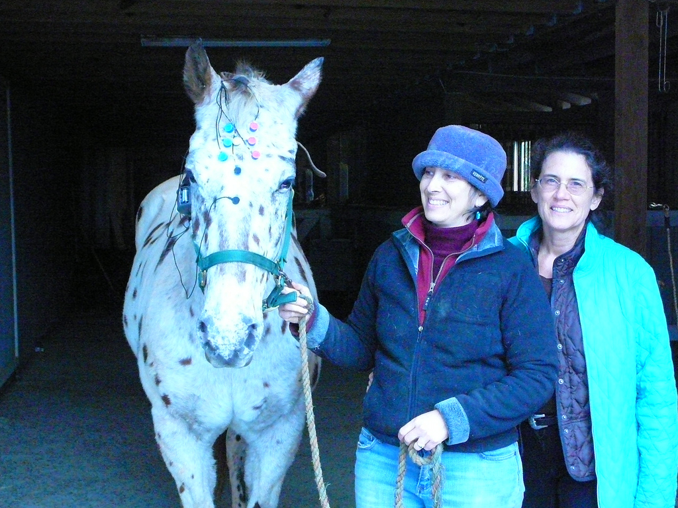
Notes:
Buttons, Sandy Rakowitz and Robin Bernhard attempt to study brain wave patterns at Spring Ridge Farm, Charlottesville, VA in November 2012.

Slide 14
Knole Farm near Lake Albemarle in Charlottesville, VA is the location of Horses as Healers.
Notes:
THERAPEUTIC RIDING AND NEUROFEEDBACK
The Virginia Center for Neurofeedback began a partnership with Horses as Healers in 2015 to provide neurofeedback and therapeutic riding to children with neurodevelopmental disorders, autism spectrum disorders and/or a variety of behavioral health challenges.
Horses as Healers has been serving Albemarle County since 2002 with a comprehensive horse program in a farm setting. For over six years, Horses as Healers has provided teachers, horses and volunteers to Camp Holiday Trails, a program that serves children who would not be able to attend traditional camp because of medical needs. The Ivy Creek School has participated in a program at Horses as Healers since 2003. Ivy Creek serves children (K-12th grade) who have emotional/behavioral challenges from all counties surrounding Charlottesville, VA. In the past, Horses as Healers has worked with both city and county children in foster care, and presently, Horses as Healers serves a wide variety of individual private clients.
The atmosphere is non-competitive and child centered. Family members are invited to participate. Interactions with staff, volunteers, family members and animals enhance psychosocial development in a supportive and playful, yet challenging and professional milieu. While many will learn to ride independently, learning to care for and develop relationships with horses offers its own benefits.
LENS Neurofeedback is offered after the therapeutic riding lesson. Neurofeedback increases mental and emotional resilience so that children can more easily handle life’s many challenges. Neurofeedback can help with anxiety, depression, impulse control, attention, cognitive processing and sleep. The natural environment is relaxing for many children who would become irritable or hyper-active in a typical office setting. For more information about neurofeedback, please visit our website: virginianeurofeedback.com.
For more information, please contact either Eleyne Fitzgerald, MA (434) 882-3610 or Robin Bernhard, LCSW, MEd, BCN at (434) 260-8141. Horses as Healers is a private non-profit program that depends upon community donations to keep its cost to clients as low as possible. The program is open, weather permitting, all year round. Opportunities are available for volunteers over the age of 14. Services are individualized and frequently adjusted to meet each client’s specific needs. Please visit their website to donate. www.horses-as-healers.org.
Eleyne Fitzgerald, the Director of Horses as Healers, has a Master’s in Psychology from The Graduate Faculty at the New School for Social Research. Eleyne started teaching riding at age 14, has been a horse trainer for many years and is a member of PATH (Professional Association of Therapeutic Horsemanship International).

Slide 15
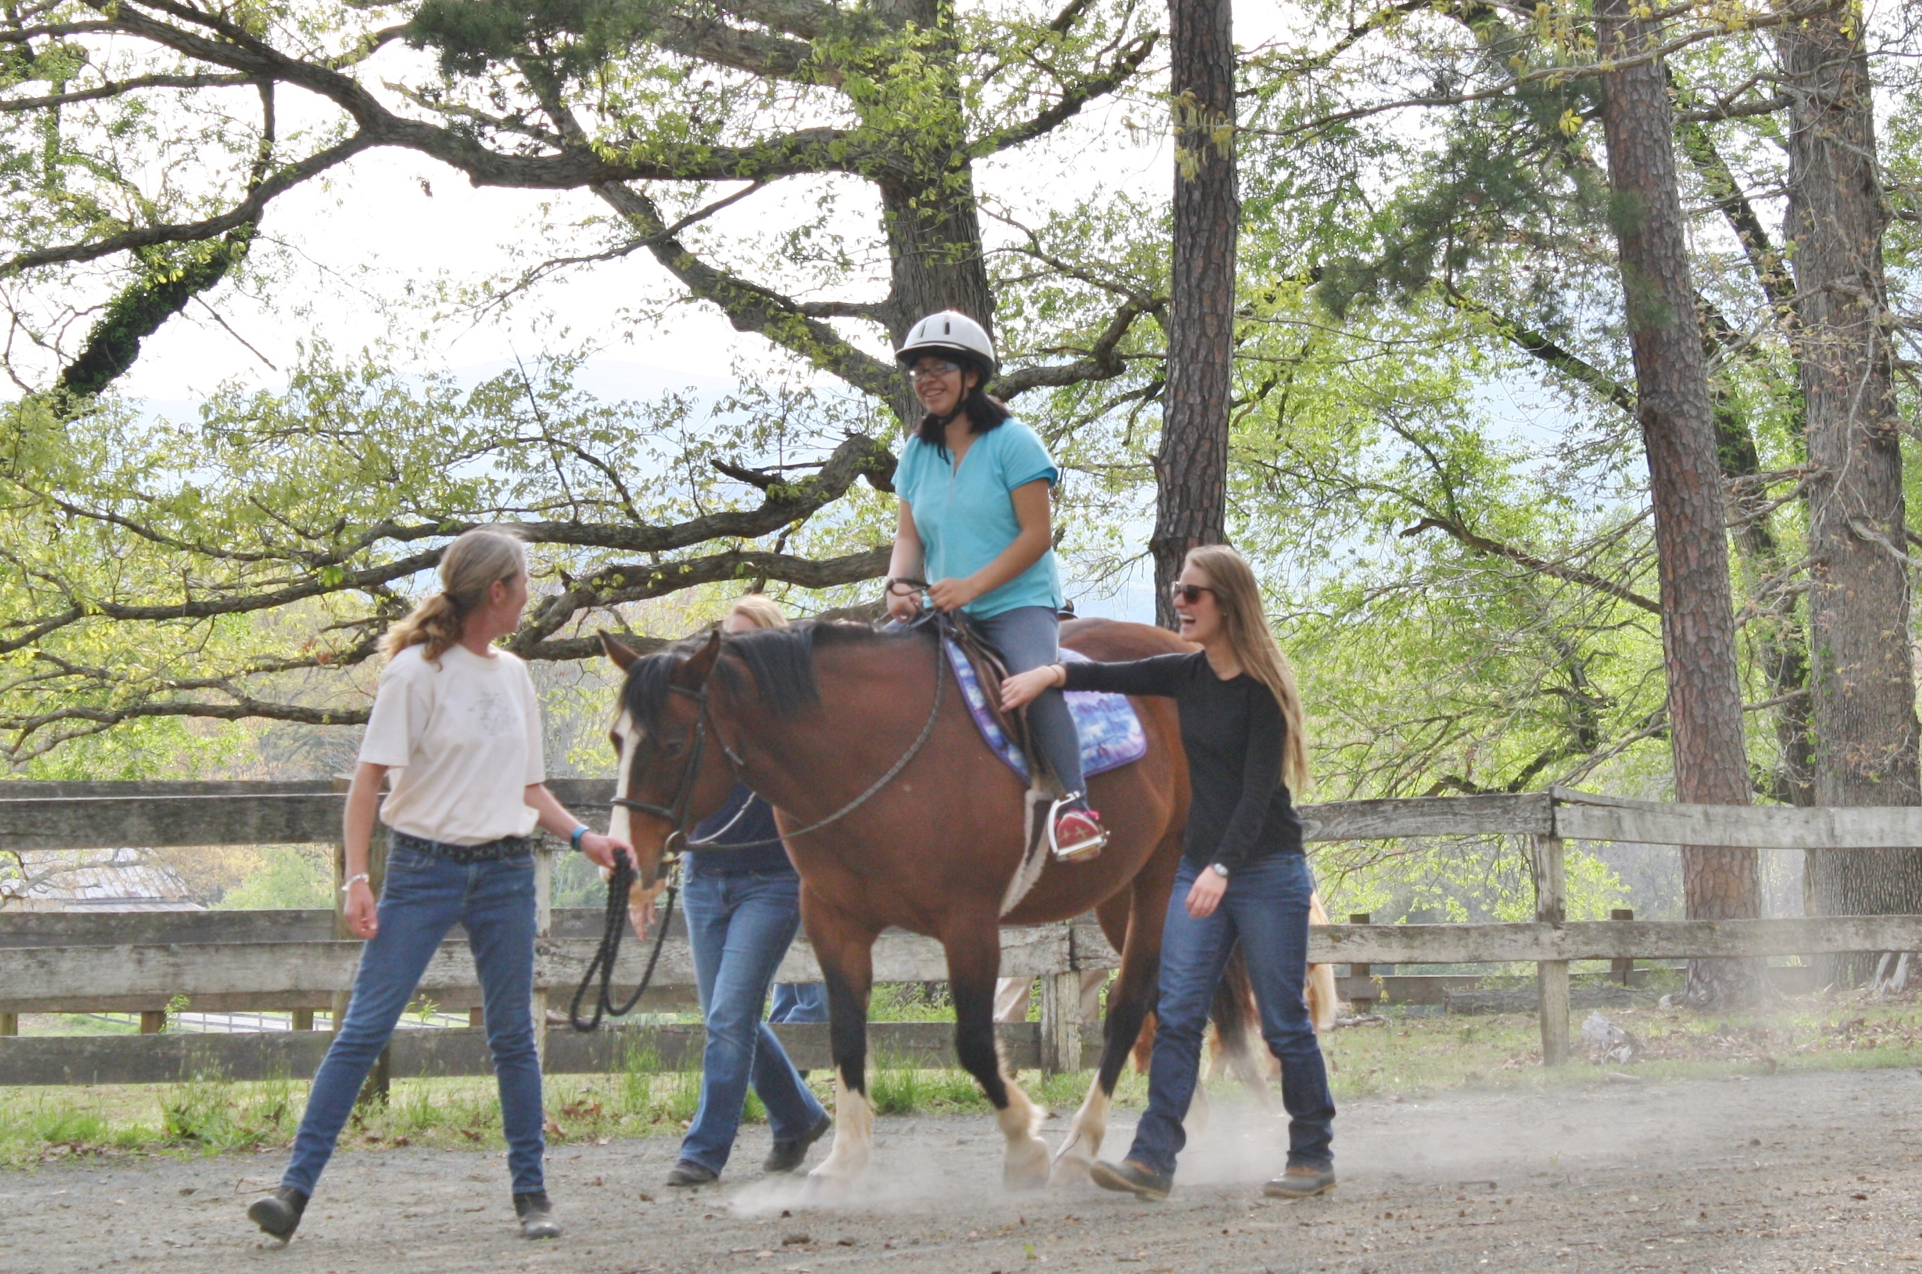
Notes:
Helping a teen recover from the effects of a stroke.

Slide 16
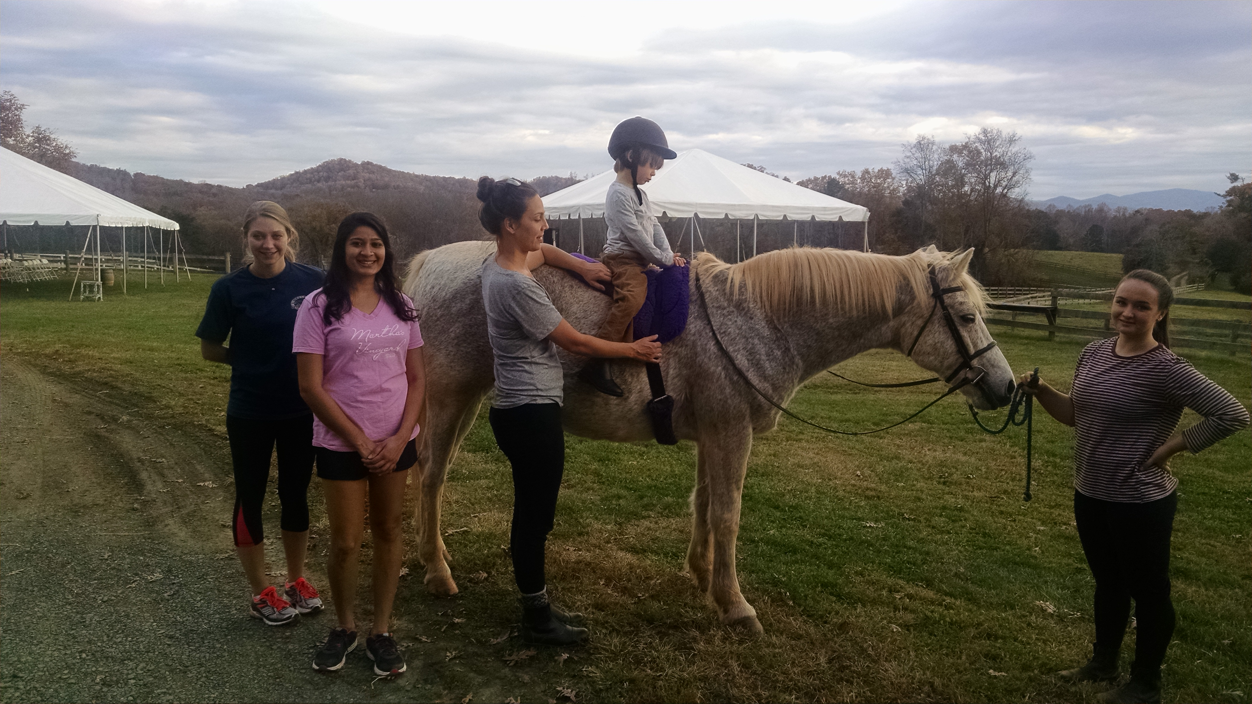
Notes:
Medical students from UVA volunteer as side walkers for their first year class requirement to participate in the local community. (This pic needs editing!)

Slide 17
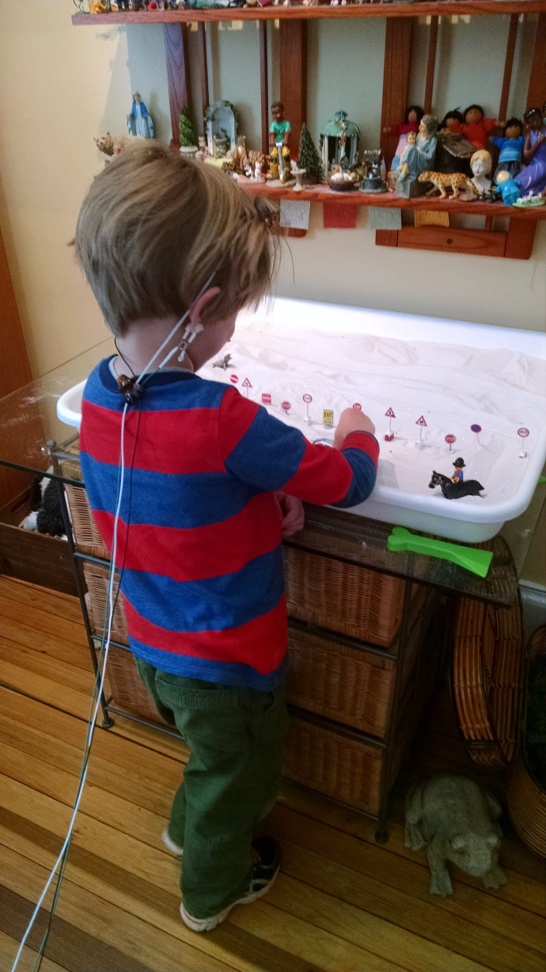
Notes:
Child receiving LENS neurofeedback.
1) If the brain could refresh itself, we would be healthier.
We do not know of mechanisms that help the brain to refresh itself after trauma.
Len Ochs believes that people who don’t need the LENS have some unknown
way to refresh their neurochemistry.
2) Trauma Shuts Down the Brain’s Ability to Communicate with Itself.
When faced with potential injury, the brain tries to protect itself
from seizures, so it suppresses activity with neurochemicals.
The chemical suppression interferes with cognitive, mood,
motivation, movement, sensory-motor function and indirectly,
with the energy and vitality of the person.
The shut-down of communication happens in varying degrees
and some people seem to have the ability to release the suppression.
3) Gentle Disruption of Old Patterns Leads to Improved Health
The LENS signal to the brain, ever so gently disrupts
the pathological brain wave patterns that have developed
over time because the brain isn’t refreshing itself.
Paradoxically, when the brain is gently disrupted by the LENS,
it tends to reorganize itself at higher level of health. The LENS
Simply lets the brain reorganize itself and doesn’t shape the
brain or attempt to control its function.

Slide 18
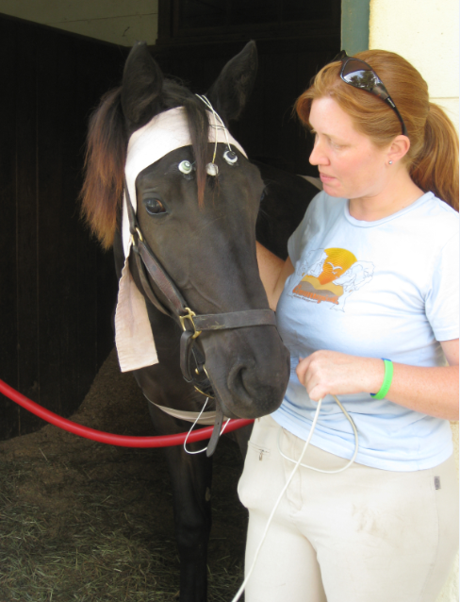
Notes:
Faith receiving Low Energy Neurofeedback (LENS) in Middleburg, VA.

Slide 19
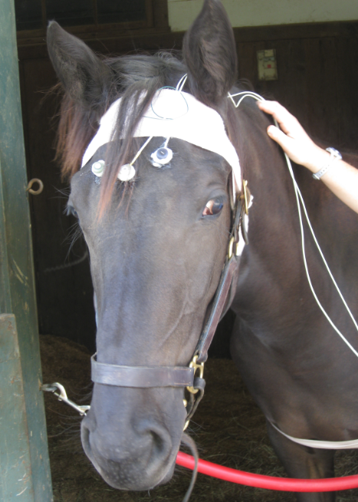
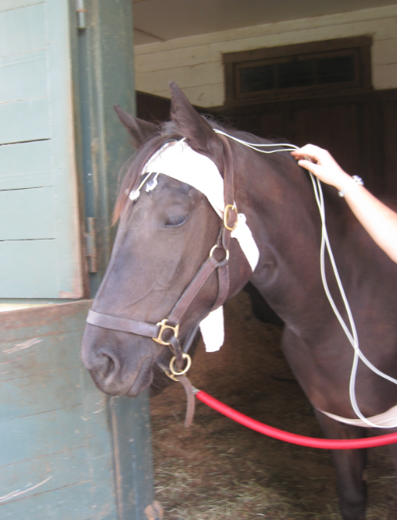
Notes:
Prior to receiving the LENS, Faith’s eyes show tension in her nervous system. During LENS treatment, Faith closes her eyes, as if she is feeling more relaxed.
Some Symptoms Believed To Be Permanent Melt Away
The LENS releases the suppression that brain uses to protect itself and opens up the microvascular system to the brain This allows large portions of the brain to receive better blood flow to nourish and cleanse brain cells.
Symptoms appear to melt away when the environment for the brain cells improves. The actual mechanism by which this happens is not known, but we believe the vascular system and the glial cells are involved.

Slide 20
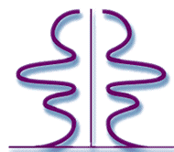
The Awakened Mind™
The Awakened Mind is an exact relationship and proportion of the clusters of brain waves
Left Hemisphere Right Hemisphere
Thinking + Visualizing
Problem Solving
Logical, Sequential
Thinking
Bridge
Relaxed Awareness
Vivid Imagery
Creative Storehouse, Inspiration and Spiritual
Connection
Unconscious Intuition
Gamma 38-42 Hz
Beta 12-38 Hz
Alpha 8-12 Hz
Theta 4-8 Hz
Delta 0.1-4 Hz

Slide 21
The Awakened Mind™
Anna Wise
Thinking + Visualizing
Numbers on the Clock + Circular Clock Face
High Energy
Gamma
Beta
Alpha
Theta
Delta
Low Energy
Narrow Focus
Dorsal Motor Vagal Emergency System
Open Focus
Orienting Response
Ventral Vagal Social
Engagement System
Les Femi
Stephen Porges

Slide 22
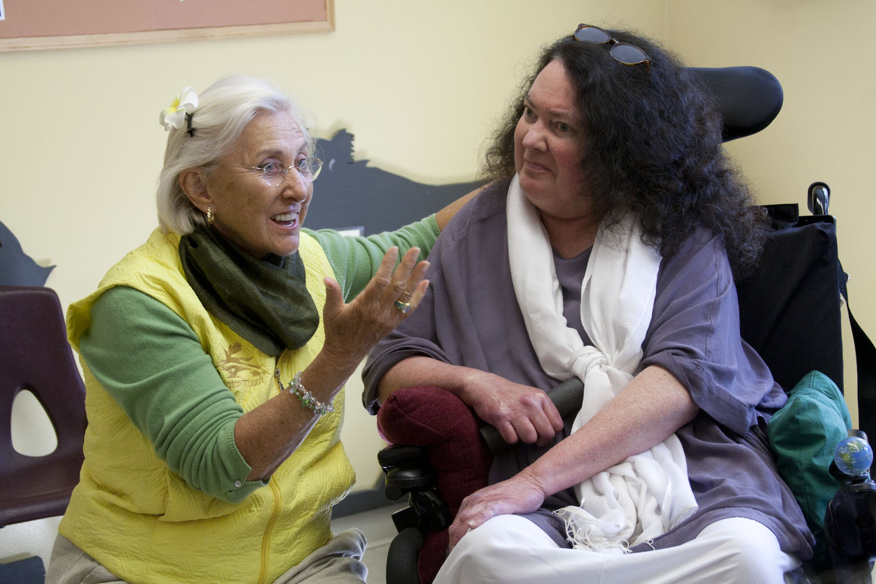
Notes:
Linda Tellington-Jones and Anna Wise at the Oakland Zoo.

Slide 23
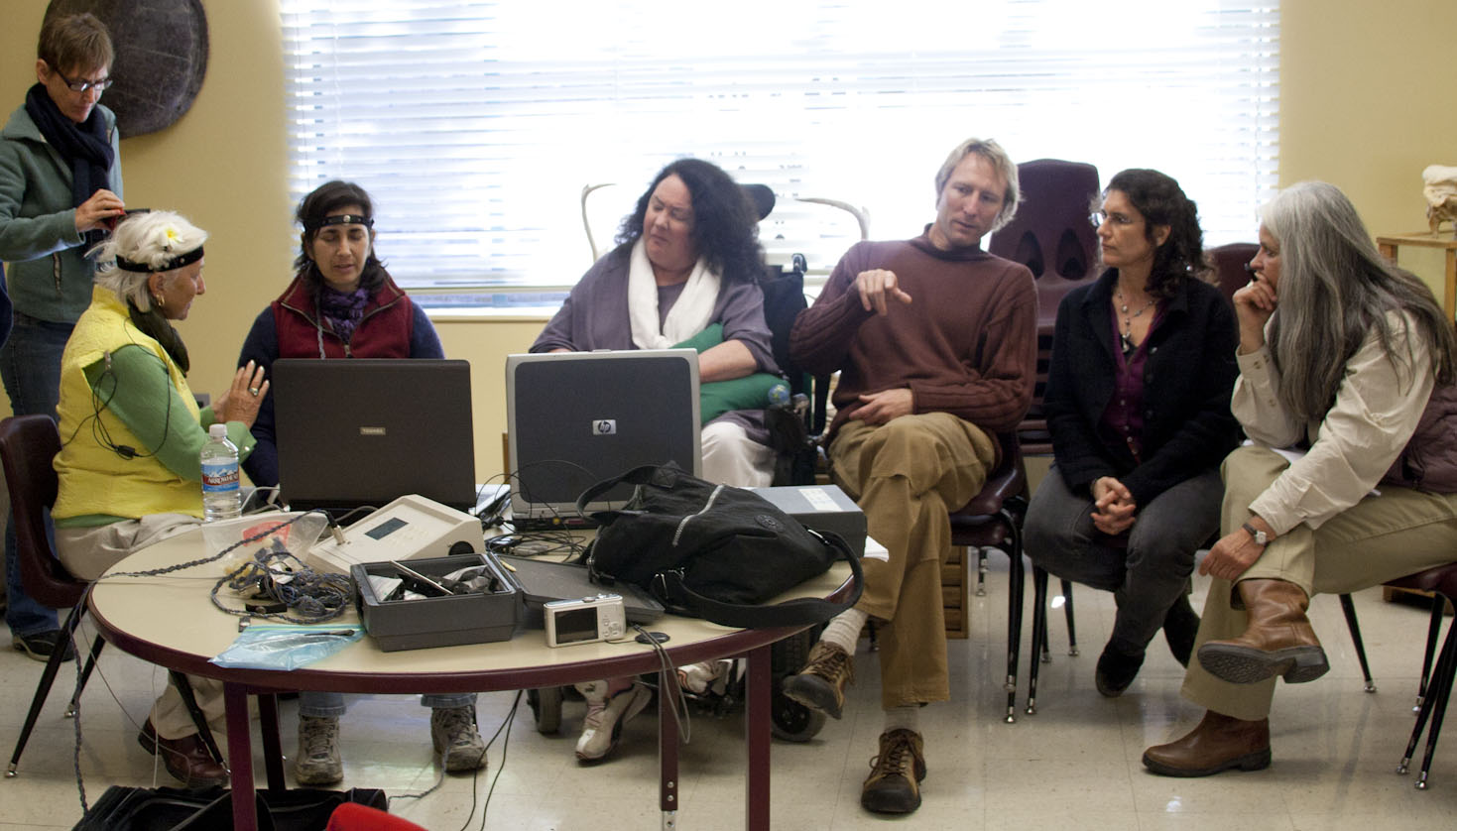
Notes:
Anna Wise at the Oakland Zoo in 2009. Linda Tellington-Jones and Sandy Rakowitz were both hooked up to the Mind Mirror. We noticed that brain wave entrainment occurred between Linda and Sandy no matter who was giving TTouch and who was receiving TTouch. There did not appear to be clear leadership of brain waves, but it appeared that one person’s brain wave patterns were leading and then shortly afterward they might be following. This suggests unconscious or pre-conscious communication between humans at the level of brain waves where leadership is a shared process.

